Slide 1
Problems of Literalism in Science and Religion

Slide 2
¹² On the day the Lord gave the Amorites over to Israel, Joshua said to the Lord in the presence of Israel:
“Sun, stand still over Gibeon, and you, moon, over the Valley of Aijalon.” ¹³ So the sun stood still, and the moon stopped, till the nation avenged itself on^{[b]} its enemies,
as it is written in the Book of Jashar.
The sun stopped in the middle of the sky and delayed going down about a full day. ¹⁴ There has never been a day like it before or since, a day when the Lord listened to a human being. Surely the Lord was fighting for Israel!

Slide 3
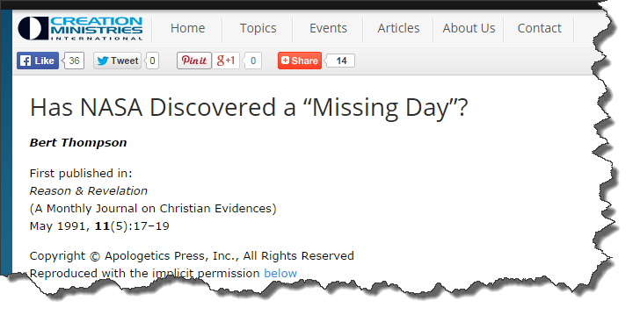

Slide 5
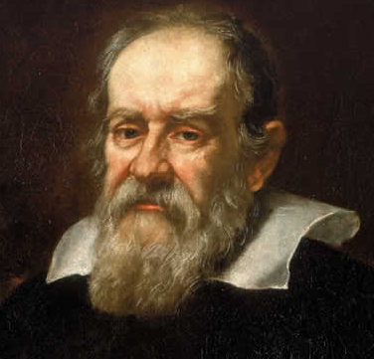
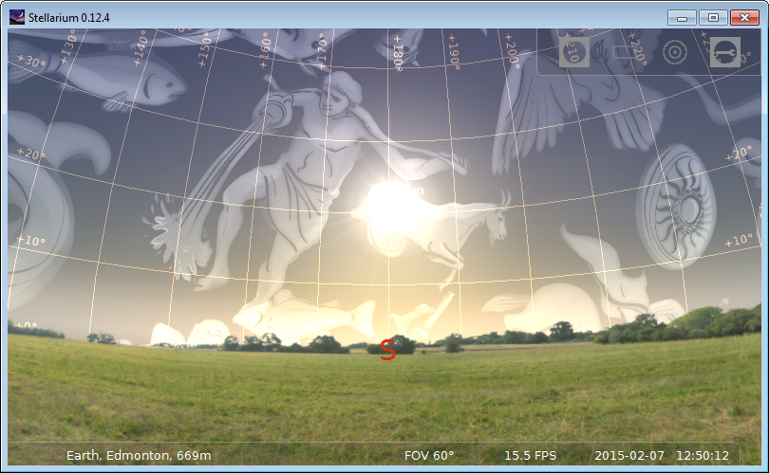
Galileo’s Response circa 1613…

Slide 6
Does a literalist reading take scripture “seriously”?
What philosophical/epistemological position gives rise to literalism?
Do we need to learn to “read” the Bible or is it clear and distinct?
Is there a corresponding form of literalism in science?

Slide 7
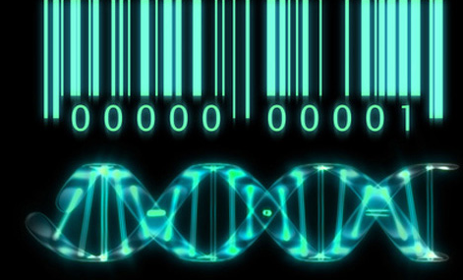
We are survival machines – robot vehicles blindly programmed to preserve the selfish molecules known as genes. This is a truth which still fills me with astonishment.
Richard Dawkins, Selfish Gene
A gene is the basic physical and functional unit of heredity. Genes, which are made up of DNA, act as instructions to make molecules called proteins. In humans, genes vary in size from a few hundred DNA bases to more than 2 million bases.

Slide 8
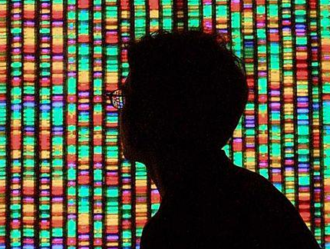
Gene, Genome…
A genome is an organism's complete set of DNA, including all of its genes. Each genome contains all of the information needed to build and maintain that organism. In humans, a copy of the entire genome—more than 3 billion DNA base pairs—is contained in all cells that have a nucleus. (definition from NIH website)

Slide 9
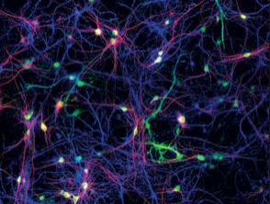
Some quick facts…
Human genome consists of about 22 000 genes (mouse 23 000!)
There are 10¹² neurons and 10¹⁶ synaptic connections in the brain
Genome is NOT a blueprint – its an algorithm
Living organisms are open systems and can only be understood in a context (environment) ➔ epigenetics

Slide 10
Modern Evolutionary Biology and Teleology
Perhaps this is a dogma (since it does not arise directly from science) but – many (most?) scientists reject a notion of goal or directedness to evolution
Epigenetics suggests that there is much more to the development of an organism than just the genome
Does a “blind” or dogmatic rejection of telos ignore a deeper mystery that seems implicit in convergent evolution?
IS there a deeper theological problem if we try to achieve concord between Christianity (theism in general) and the prevailing view of evolutionary biology?
What part of modern evolutionary biology would you change?
What are the risks of introducing a teleology into biology?
Good reads: Chp 18, 21 of McGrath

Slide 11
Other examples of “scientific literalism”
Electron spin
Bohr atom
Molecular orbitals
IF taken as “literal fact” each is limiting or leads to a nonsensical result. Properly “bracketed” they can or have served as useful models

